Slide 1
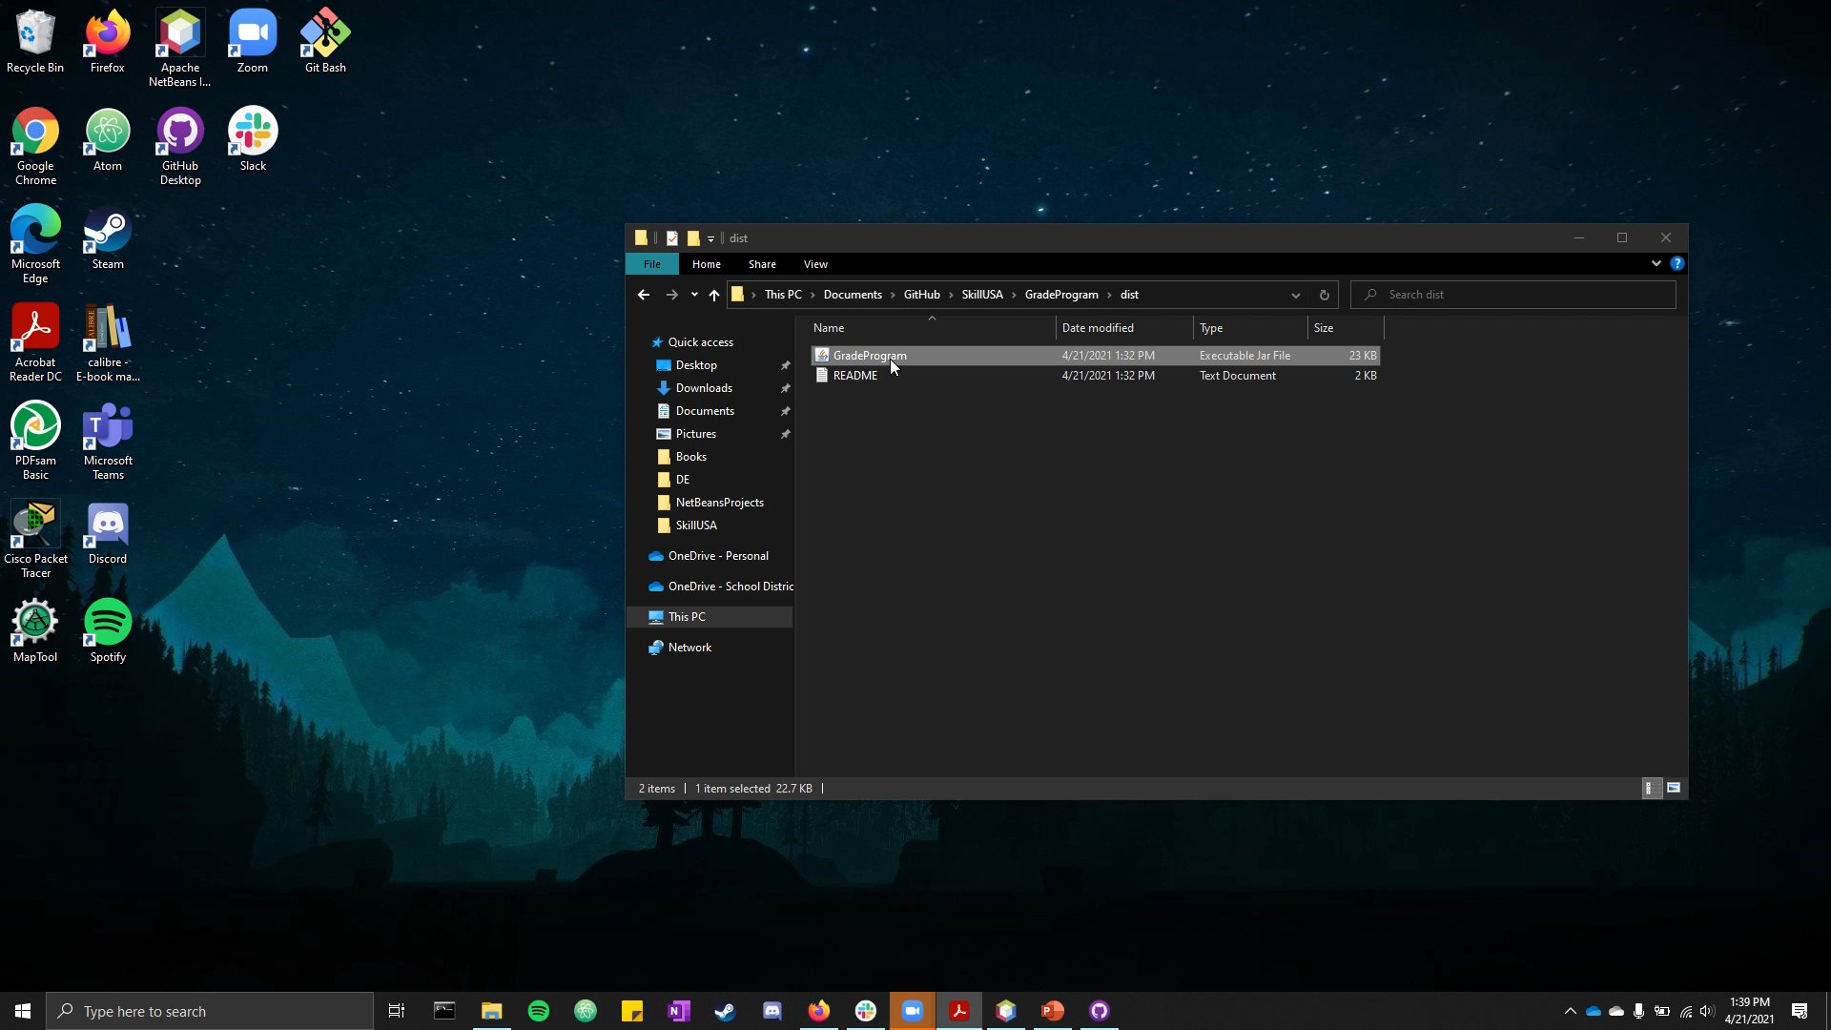
Allie Bacholl Program #2 Grade Program

